Slide 1
Selenium Webdriver
Workshop

Slide 2
Content
Automation Principles
Selenium WebDriver
Test Framework

Slide 3
Automation Principles

Slide 4
Why Test Automation
Supports execution of repeated test cases
Enables parallel execution
Encourages unattended execution
Improves accuracy thereby reducing human generated errors
Saves time and money
Reduce redundancy
High ROI
Faster GoTo market

Slide 5
Selenium Webdriver

Slide 6
Selenium
Selenium is a portable testing framework for web and mobile applications
Selenium
Web-based Automation Testing
Open Source
Multiple frameworks
Multiple program languages
Multiple browsers
Multiple OS

Slide 7
Selenium Webdriver
Selenium is a set of different software tools each with a different approach to supporting test automation.
Webdriver provides a programming interface for driving the browser for automation tests, using JSON Wire Protocol.
Selenium IDE
Selenium RC
Selenium WebDriver
Selenium GRID
History
Was first developed in 2004 by Jason Huggins as a JavaScript library that could interact with the page
In 2006 – Google engineers (Simon Stewart) start working on Selenium Webdriver
In 2011 – Release of WebDriver (Selenium 2)
In 2013 – Release of Webdriver2 (Selenium 3)

Slide 8
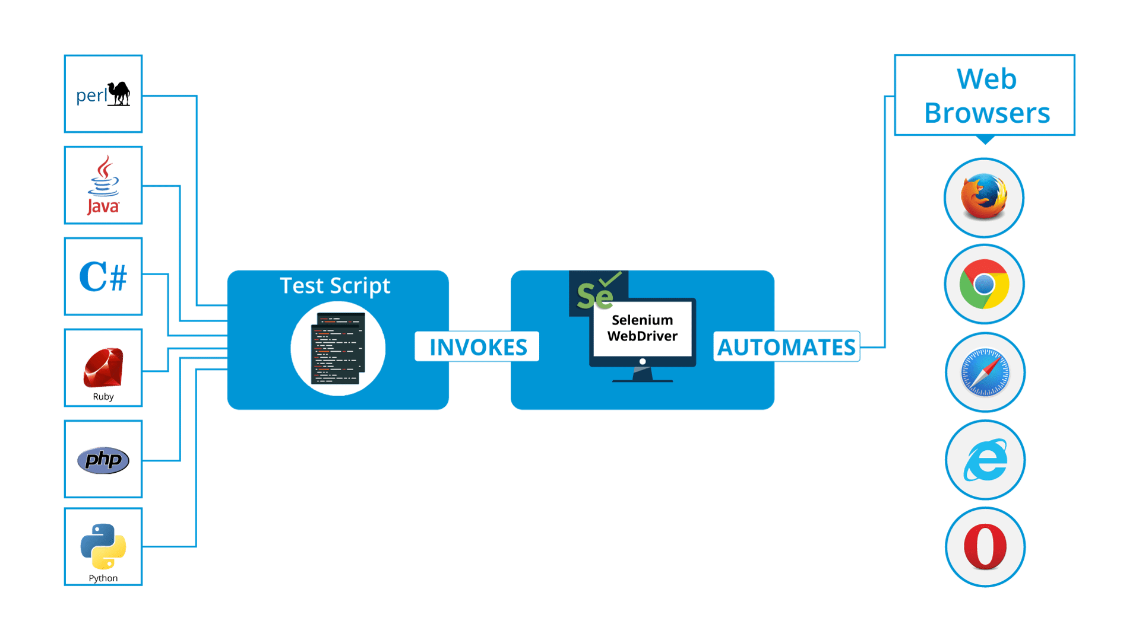
Selenium

Slide 9
Selenese
Actions
commands that generally
manipulates the state of the
application ( click this link,
select that option)
Accessors
examine the state of the
application and store the
results in a variable
(storeTitle)
Assertions
they verify that the state of
the application conforms to
what is expected
(verify, assert, waitFor)

Slide 10
Selenium Config
Install NuGet:
- Selenium.WebDriver
- Selenium.Support
- Selenium.Chrome.WebDriver
- Selenium.Firefox.WebDriver
- xUnit

Slide 11
xunit
Xunit
- is a free, open source, community-focused unit testing tool for the .NET Framework
- written by the original inventor of NUnit v2, xUnit.net is the latest technology for unit testing C#, F#, VB.NET and other .NET languages
Constructor and Dispose
- shared setup/cleanup code without sharing object instances
- IDisposable interface to your test class, and the cleanup code in the Dispose() method
Fact Attribute
- indicates a fact that needs to be run by the test runner
[Fact]
[Fact(DisplayName = "GIVEN the google homepage is open WHEN searching for new york times THEN results should appear")]

Slide 12
WebDriver – Invoking the browser
public class Tests : IDisposable
{
public IWebDriver driver;
public Tests() {
try{
driver = new ChromeDriver();
}
catch (Exception e) {
Console.WriteLine("exception" +e);
}
}

Slide 13
WebDriver – Navigate to URL
driver.Navigate().GoToUrl("https://www.fly-go.ro/");
driver.Manage().Window.Maximize();
driver.Navigate().Back();
driver.Navigate().Forward();
driver.Navigate().Refresh();
driver.Title();

Slide 14
WebDriver – Locating the elements
By ID
By Class Name
By Tag Name
By Name
By Link Text
By CSS
By Xpath
Using Javascript
IWebElementelement=driver.FindElement(By.Id(“ID"));
List<WebElement>cheeses=driver.findElements(By.className(“myClass"));
IWebElementframe=driver.FindElement(By.TagName("iframe"));
IWebElementcheese=driver.FindElement(By.Name(“name"));
IWebElementcheese=driver.FindElement(By.LinkText(“linktext"));
IWebElementcheese=driver.FindElement(By.CssSelector("#css"));
IList<IWebElement>labels=driver.FindElements(By.TagName("label"));
IList<IWebElement>inputs=(IList<IWebElement>)((IJavaScriptExecutor)driver).ExecuteScript("var labels = arguments[0], inputs = []; for (var i=0; i < labels.length; i++){"+"inputs.push(document.getElementById(labels[i].getAttribute('for'))); } return inputs;",labels);
IWebElementframe=driver.FindElement(By.XPath(“xpath"));

Slide 15
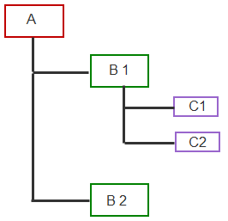
Xpath
Absolute
Relative
Axis | Description | Example from above figure
descendant | Children of the current node and their children too. | All the nodes are descendant of node A
ancestor | Parent of current node and their parent. | B1 and A are ancestor of C1.
following-sibling | following siblings | C2 is following sibling of C1 and B2 is following sibling of B1
preceding-sibling | preceding siblings | C1 is preceding sibling of C2 and B1 is preceding sibling of B2
following | following siblings and their descendants. | B2 is following for B1.
parent | parent of the current node. | B1 is parent of C1.
preceding | preceding siblings and their descendants. | B1, C1 and C2 are preceding to B2.
parent
children
siblings
ancestor
descendant

Slide 16
XPath
<div id="inputs" class="yui-skin-sam">
<input id="username" type="text" value="" placeholder="ID Yahoo" aria-required="true" tabindex="1" maxlength="96" name="login">
<input id="passwd" type="password" value="" placeholder="Parolă" aria-required="true" tabindex="2" maxlength="64" name="passwd">
<div id="captchaDiv"></div>
<div id="persistency">
<input id="persistent" type="hidden" value="" name=".persistent" style="background-color: rgb(255, 255, 255);">
<span id="pLabel" tabindex="3" for="persistent">
<span id="pLabelC" class="checkbox lg-sprite "> </span>
<span class="labeltxt">Păstrează-mă autentificat</span>
</span>
</div>
<div id="submit">
<button id=".save" class="lgbx-btn purple-bg" tabindex="4" name=".save" type="submit">Autentificare</button>
</div>
Element | XPATH | CSS
password field | //div[@id='inputs']/input[@id='passwd'] | css=div[id='inputs'] input[id='passwd'] css=div#inputs input#passwd
 | //div[@class='yui-skin-sam']/input[@id='passwd'] | css=.yui-skin-sam input#passwd
 | //div/input[contains(@placeholder,'Parolă')] | css=div input[placeholder=Parolă]
 | //div/input[@name="passwd"] | css=div input[name="passwd"]
 | //div/input[@name="passwd"][@id="passwd"] | css=div input[name="passwd"][id="passwd"]
 | //div/input[@name="login"]/following::input | css=div input[name="login"] ~ input
button | //div/button[contains(text(),'Autentificare')] | css=div button:contains('Autentificare')

Slide 17
Interacting with elements
//Enter text
driver.FindElement(By.Xpath(“xpath")).SendKeys(“myText");
//Click
driver.FindElement(By.Name(“name")).Click();
//Get text
driver.FindElement(By.XPath(“XPath")).Text
//Select
new SelectElement(driver.FindElement(By.Name(“name"))).SelectByText(“TextToSelect)");

Slide 18
Interacting with elements
// switch to window
driver.SwitchTo().Window("windowName");
//pop-up
Alert alert = driver.SwitchTo().Alert();
//drag and drop
IWebElement element = driver.FindElement(By.Name("source"));
IWebElement target = driver.FindElement(By.Name("target"));
(new Actions(driver)).DragAndDrop(element, target).Perform();

Slide 19
Explicit and implicit wait
Explicit
WebDriverWait wait = new WebDriverWait(driver, TimeSpan.FromSeconds(10));
wait.Until(ExpectedConditions.ElementToBeClickable(By.XPath(“XPath")));
Implicit
driver.Manage().Timeouts().ImplicitWait = TimeSpan.FromSeconds(10);

Slide 20
Test Framework

Slide 21
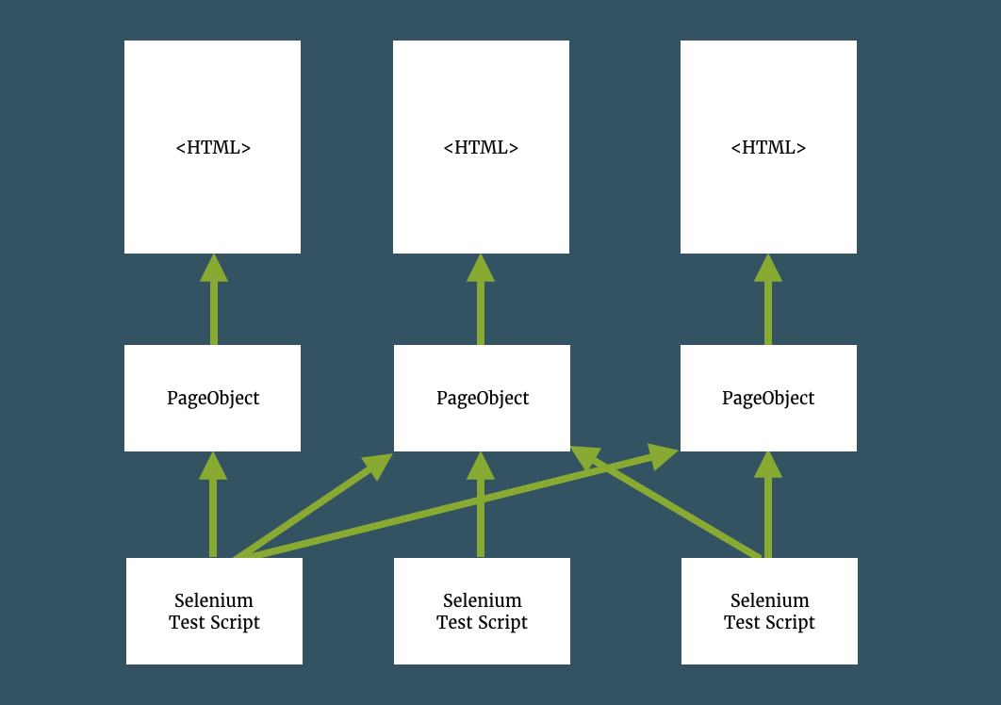
Page Object Pattern
A Page Object models the user interactions with the page as objects within the code.
This reduces the amount of duplicated code and means that if the UI changes, the fix need only be applied in one place.

Slide 22
https://www.mindmeister.com/334652100/mymindmap
https://www.w3schools.com/xml/xpath_intro.asp
https://medium.com/tech-tajawal/page-object-model-pom-design-pattern-f9588630800b
https://thefriendlytester.co.uk/2014/05/pageobject-pattern-why-how-and-more.html

Slide 23
API TESTING APPROACH

Slide 24

Let’s TEST!

